Slide 1
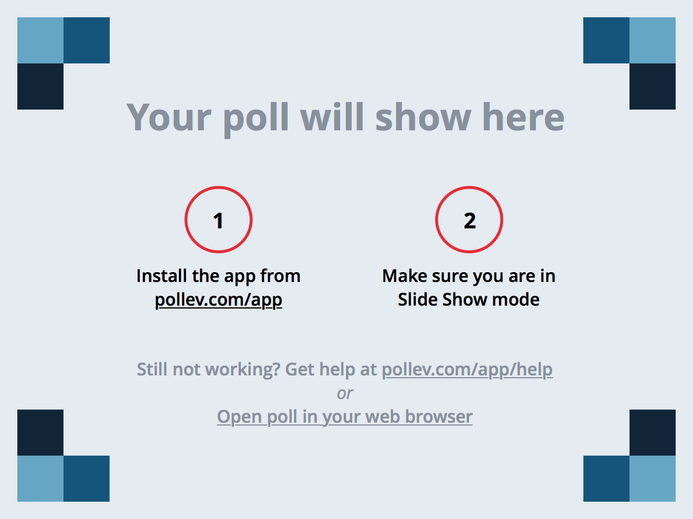
Notes:
Poll Title: How's the pace of the class treating you so far? https://www.polleverywhere.com/multiple_choice_polls/7byPuOfCtkiAuXo

Slide 2
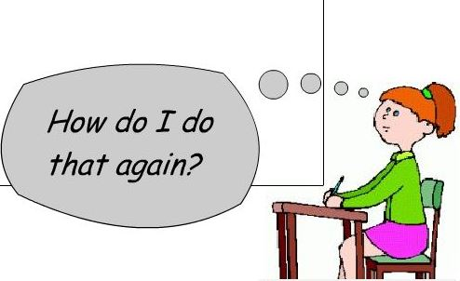

It’s Okay!
© 2016 | RCB - All Rights Reserved
Notes:
7:00 – 7:05

Slide 3
Where to Get Help
Practice, Practice, Practice: Work Individually or in Groups
Review In Class Material (Exercises and Slides): https://github.com/RutgersCodingBootcamp/0125-mw-class-content
Re-Watch Class Videos:
https://github.com/RutgersCodingBootcamp/All-Classwork-Homework/blob/master/class-recordings.md
In Class Office Hours: 45 minutes before class, 30 minutes after
Virtual Office Hours: Tuesdays 6:30 – 8:00 PM
Ahmed’s Advanced Workshops: By Announcement
Contact Student Success: Message Stacey, anytime!
© 2016 | RCB - All Rights Reserved
© 2016 | Rutgers Coding Bootcamp - All Rights Reserved

Slide 4
Homework Assignment
Also, at this point everyone should have access to the homework repository in GitHub. https://github.com/RutgersCodingBootcamp/All-Classwork-Homework
Homework Assignment #1 is Due on Monday (2/1/16)
© 2016 | RCB - All Rights Reserved
© 2016 | Rutgers Coding Bootcamp - All Rights Reserved

Slide 5

Git’n Pro with HTML/CSS
Day 2
Rutgers Coding Bootcamp | January 27, 2016
© 2016 | RCB - All Rights Reserved
Notes:
Start at 6:45 PM

Slide 6
Today’s Objectives
Students will understand the importance of Git Version Control and how to use it
Students will create GitHub Repositories, push code into them, and share with class
Students will make more HTML documents
Students will learn to properly use basic HTML tags
Students will implement basic CSS styling to HTML documents.
© 2016 | RCB - All Rights Reserved
© 2016 | Rutgers Coding Bootcamp - All Rights Reserved

Slide 7
Know Thyself
If you are a complete beginner to HTML/CSS and Coding…
Continue getting comfortable with HTML.
Be able to completely write a basic HTML document (like in last class)
Understand what CSS is, what its for, and how it works with HTML
********** Be able to use Git and GitHub to upload code
If you’ve had past exposure and felt comfortable with the last lesson…
Aim to build up your skills. Clear up questions or confusions about HTML
Become knowledgeable about a wider range of HTML and CSS tags
Be able to selectively apply CSS to specific HTML elements
********* Be able to use Git and GitHub to upload code.
© 2016 | RCB - All Rights Reserved
© 2016 | Rutgers Coding Bootcamp - All Rights Reserved

Slide 8
What / Why Git?
© 2016 | RCB - All Rights Reserved
Notes:
7:00 – 7:05

Slide 9

The Group Project
OMG. I HAZ THE GREATEST HTML IDEA!!!!!
JORDAN’S JAMZZZZ!!!!
© 2016 | RCB - All Rights Reserved
Notes:
7:00 – 7:05

Slide 10

The Group Project
Programming Away…
© 2016 | RCB - All Rights Reserved
Notes:
7:00 – 7:05

Slide 11

The Group Project
Programming Away…
Jordan’s idea is dumb. We should call it…
JASMINE’S JAMZZZZ!!!!
© 2016 | RCB - All Rights Reserved
Notes:
7:00 – 7:05

Slide 12
The Group Project
Programming Away…
Jordan’s Version
Programming Away…
Jasmine’s Version
© 2016 | RCB - All Rights Reserved
Notes:
7:00 – 7:05

Slide 13
The Group Project – Tragedy #1
Programming Away…
Now they have two completely different versions.
Programming Away…
© 2016 | RCB - All Rights Reserved
Notes:
7:00 – 7:05

Slide 14
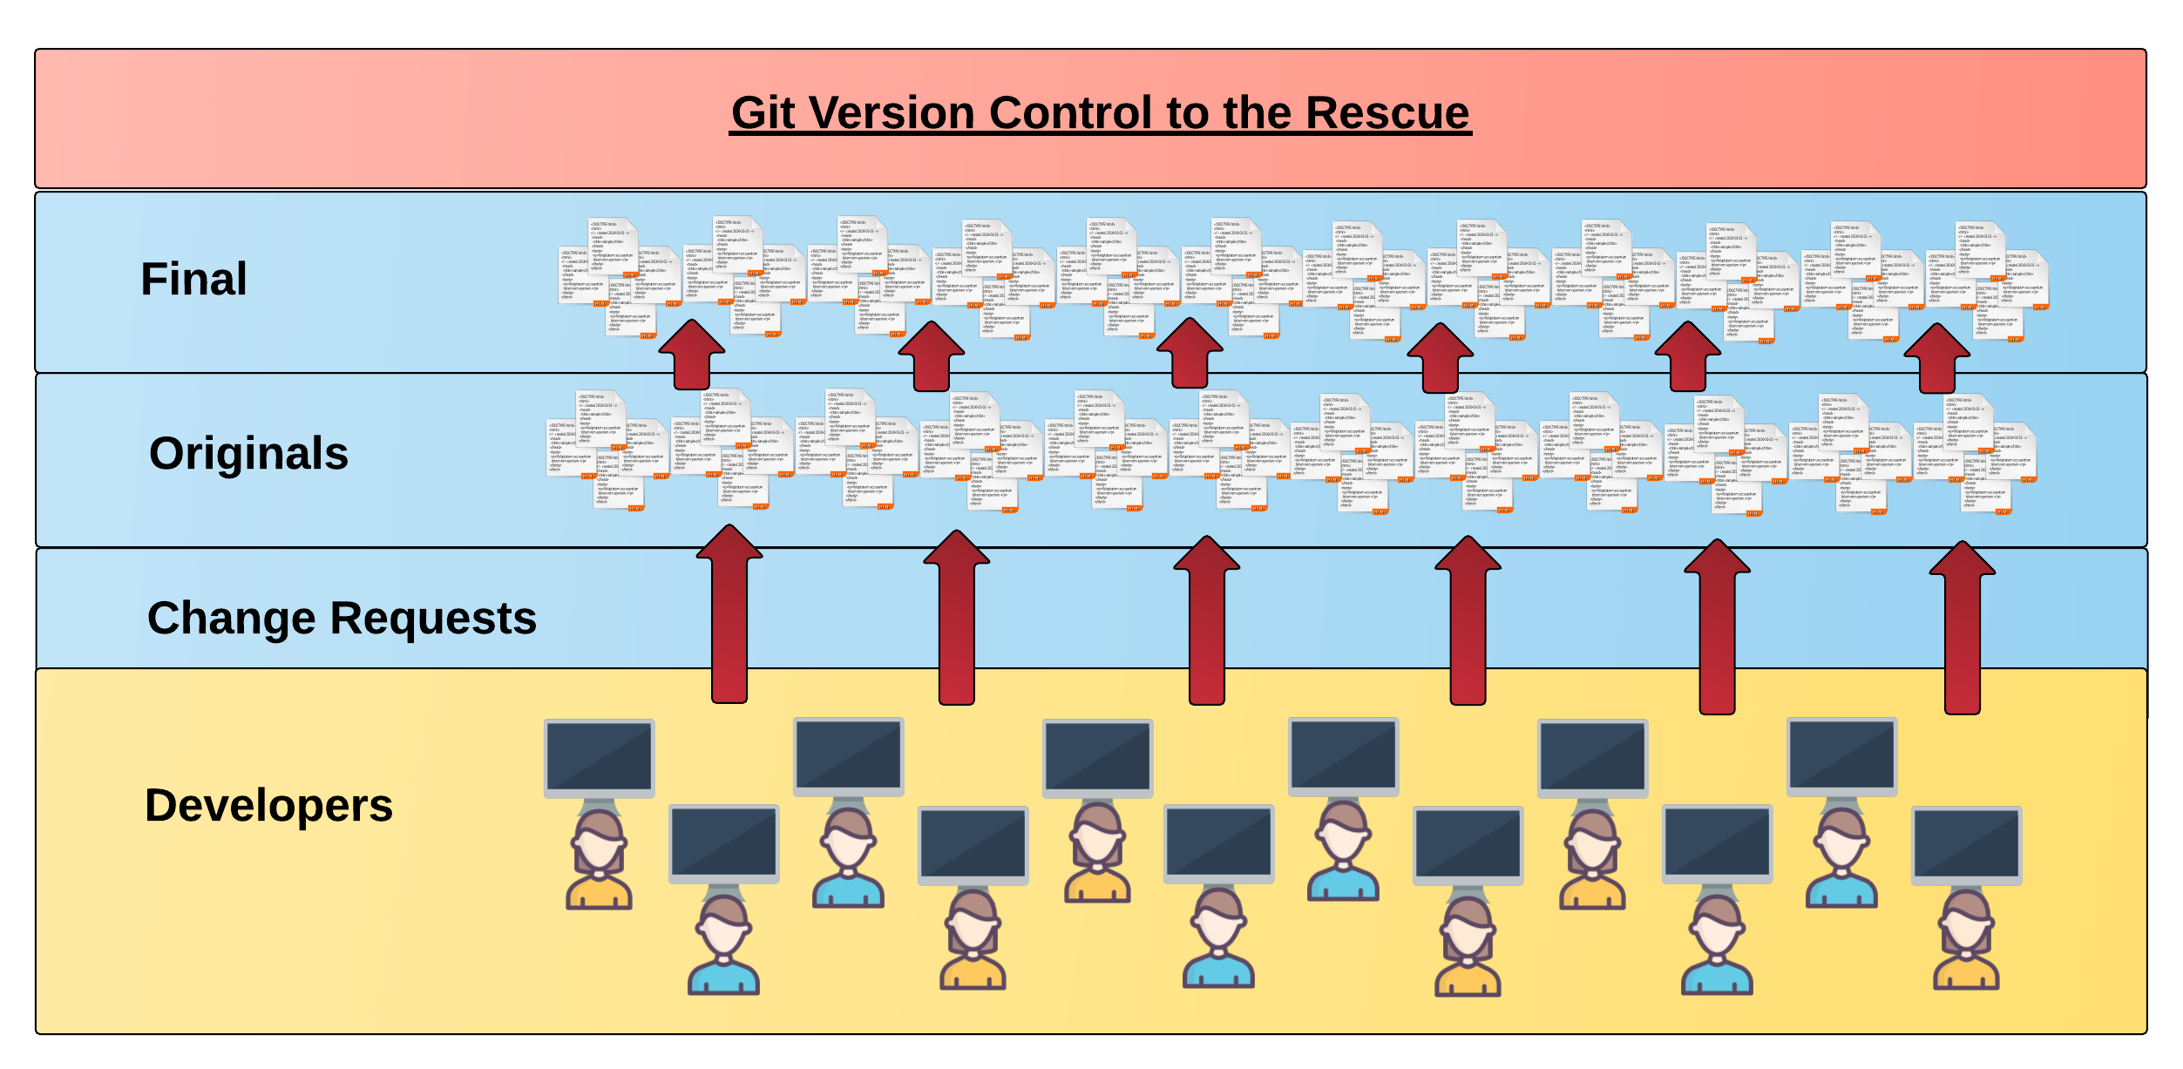
Collaborative Coding
Modern web development is highly collaborative.
Teams are often extremely large and separated across country (or planet).
Applications are often made up of hundreds or thousands of files.
© 2016 | RCB - All Rights Reserved
© 2016 | Rutgers Coding Bootcamp - All Rights Reserved

Slide 15

The Group Project
Programming Away…
Programming Away…
© 2016 | RCB - All Rights Reserved
Notes:
7:00 – 7:05

Slide 16
The Group Project
Programming Away…
Hai guyz!!!
How R Kan help??
Programming Away…
© 2016 | RCB - All Rights Reserved
Notes:
7:00 – 7:05

Slide 17
The Group Project – Tragedy #2
Programming Away…
OK.
Delete. Delete. Delete. Delete.
Delete. Delete
Programming Away…
© 2016 | RCB - All Rights Reserved
Notes:
7:00 – 7:05

Slide 18
Moral of the Story
Lesson:
You should use Version Control.
….And be wary of Walter.
© 2016 | RCB - All Rights Reserved
Notes:
7:00 – 7:05

Slide 19
Version Control
Git Version Control: Offers a set of commands and an organizational structure for managing code when multiple developers work simultaneously.
Major Benefits come from using Git:
Code Conflict Resolution
Version History
© 2016 | RCB - All Rights Reserved
© 2016 | Rutgers Coding Bootcamp - All Rights Reserved

Slide 20
The Group Project – Tragedy 1 (Revisited)
Programming Away…
Now they have two completely different versions.
Programming Away…
© 2016 | RCB - All Rights Reserved
Notes:
7:00 – 7:05

Slide 21
The Group Project with Version Control
Main Branch (Jordan’s)
Jordan continues programming
1
2
3
4
5
Jasmine pushes (uploads) her code changes into the main branch.
Code conflicts are resolved before inclusion.
Jasmine’s Branch
© 2016 | RCB - All Rights Reserved
Notes:
7:00 – 7:05

Slide 22
The Group Project – Tragedy 2 (Revisited)
Programming Away…
OKAY!
Delete. Delete. Delete. Delete.
Delete. Delete
Programming Away…
© 2016 | RCB - All Rights Reserved
Notes:
7:00 – 7:05

Slide 23
The Group Project with Version Control
Main Branch (Jordan’s)
1
2
3
4
Walter pushes his (bad) code deletions
Walter’s Branch
© 2016 | RCB - All Rights Reserved
Notes:
7:00 – 7:05

Slide 24
The Group Project with Version Control
Main Branch (Jordan’s)
1
2
3
4
5
But this time, Jordan rolls back the code to an earlier version.
Walter’s Branch
© 2016 | RCB - All Rights Reserved
Notes:
7:00 – 7:05

Slide 25
Moral of the Story
Lesson:
You should use Version Control.
….But still be wary of Walter.
© 2016 | RCB - All Rights Reserved
Notes:
7:00 – 7:05

Slide 26
Quick Activity!
Turn to your neighbor and have one of you explain to the other:
What the concept of version control is
Then the other should explain :
Two of the key advantages to using a version control system
© 2016 | RCB - All Rights Reserved
Notes:
8:20 -8:35

Slide 27

So… What’s this GitHub?
GitHub is a Web-Based hosting service to store code online.
It allows developers to pull (download) code or push (upload) code to the same repository (directory).
It also allows developers to view histories of code changes and track issues.
© 2016 | RCB - All Rights Reserved
© 2016 | Rutgers Coding Bootcamp - All Rights Reserved

Slide 28




Pushing and Pulling to GitHub
1
2
3
4
GitHub Branch
Pull Code
Push Code
Pull Code
Push Code
Pull Code
Push Code
© 2016 | RCB - All Rights Reserved
© 2016 | Rutgers Coding Bootcamp - All Rights Reserved

Slide 29
Get Started with Git
© 2016 | RCB - All Rights Reserved
Notes:
7:00 – 7:05

Slide 30
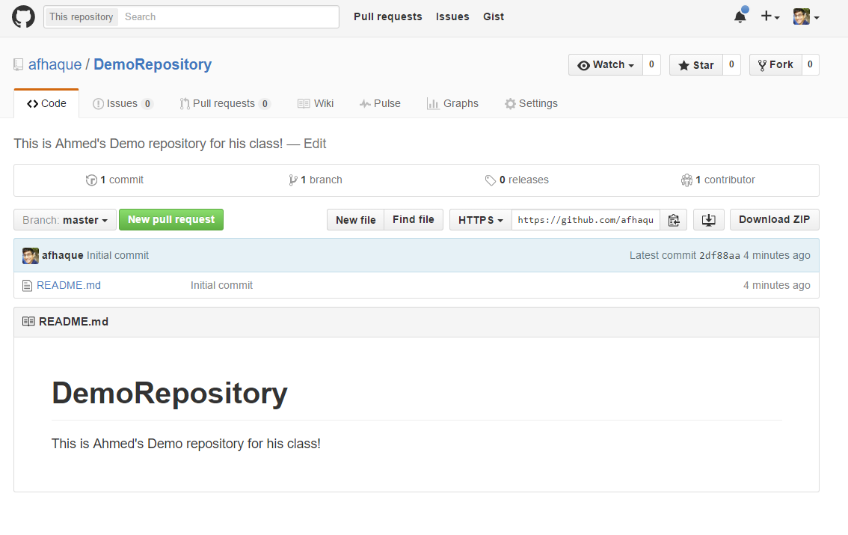
My First Repo
© 2016 | RCB - All Rights Reserved
© 2016 | Rutgers Coding Bootcamp - All Rights Reserved

Slide 31
Basic Git Commands
At its most basic, these are the five git commands to get started
git clone
git add
git commit
git push
git pull
© 2016 | RCB - All Rights Reserved
© 2016 | Rutgers Coding Bootcamp - All Rights Reserved

Slide 32
Basic Git Commands
At its most basic, these are the five git commands to get started
git clone – copies an entire repo (to begin)
git add – adds a file for inclusion in Git
git commit – notes a change to the local repo
git push – sends changes to hosting service
git pull – downloads freshest version of repo
© 2016 | RCB - All Rights Reserved
© 2016 | Rutgers Coding Bootcamp - All Rights Reserved

Slide 33
> YOUR TURN!!
Assignment:
Using GitHub and the Command Line:
Create a new public GitHub repository and name it whatever you like. Be sure to check the box for “initialize this repository with a README”
Next, clone the repo to your local directory.
Then create an HTML file inside the local directory.
Add, Commit, and Push the code to GitHub.
Bonus:
Find a partner in class and fork their repository to your own GitHub account. Clone this forked repository to your local directory.
Add, Commit, and Push the code back to your forked copy.
Finally, submit a pull request to send your changes to your partner’s repo.
© 2016 | RCB - All Rights Reserved
Notes:
Send snapshot from Git command line

Slide 34
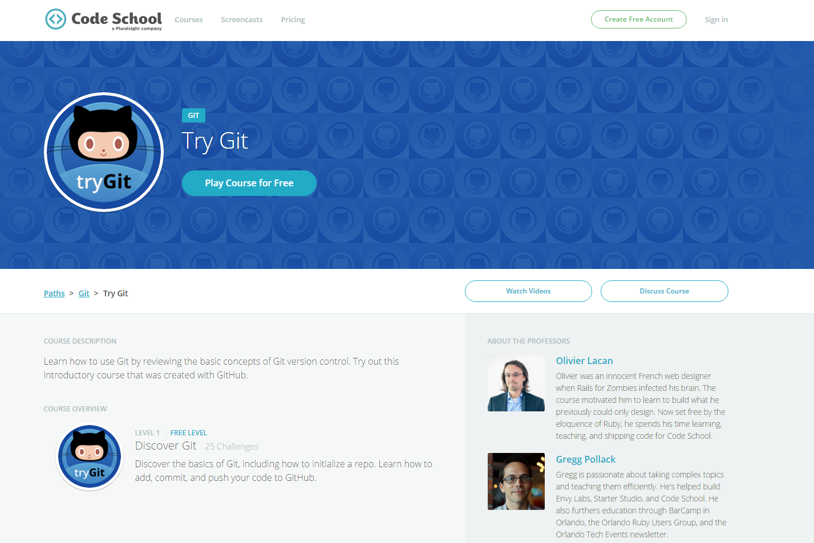
Still a bit lost? Recommended (Free) Course
https://www.codeschool.com/courses/try-git
© 2016 | RCB - All Rights Reserved
© 2016 | Rutgers Coding Bootcamp - All Rights Reserved

Slide 35
Break!
© 2016 | RCB - All Rights Reserved
Notes:
7:00 – 7:05

Slide 36
HTML Round 2
© 2016 | RCB - All Rights Reserved
Notes:
7:00 – 7:05

Slide 37
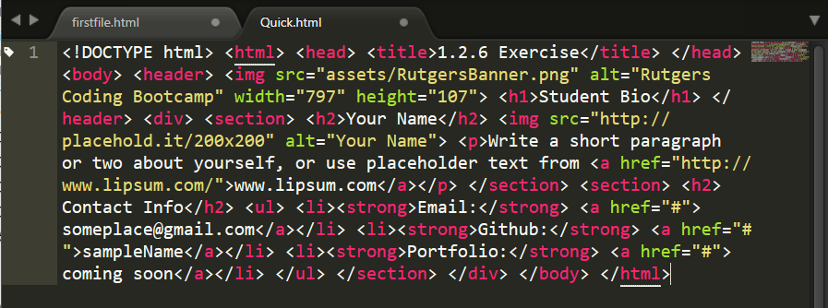
On Ugly HTML
Don’t do this… Use proper indentation and sectioning.
Readable code is easier to maintain.
© 2016 | RCB - All Rights Reserved
© 2016 | Rutgers Coding Bootcamp - All Rights Reserved

Slide 38
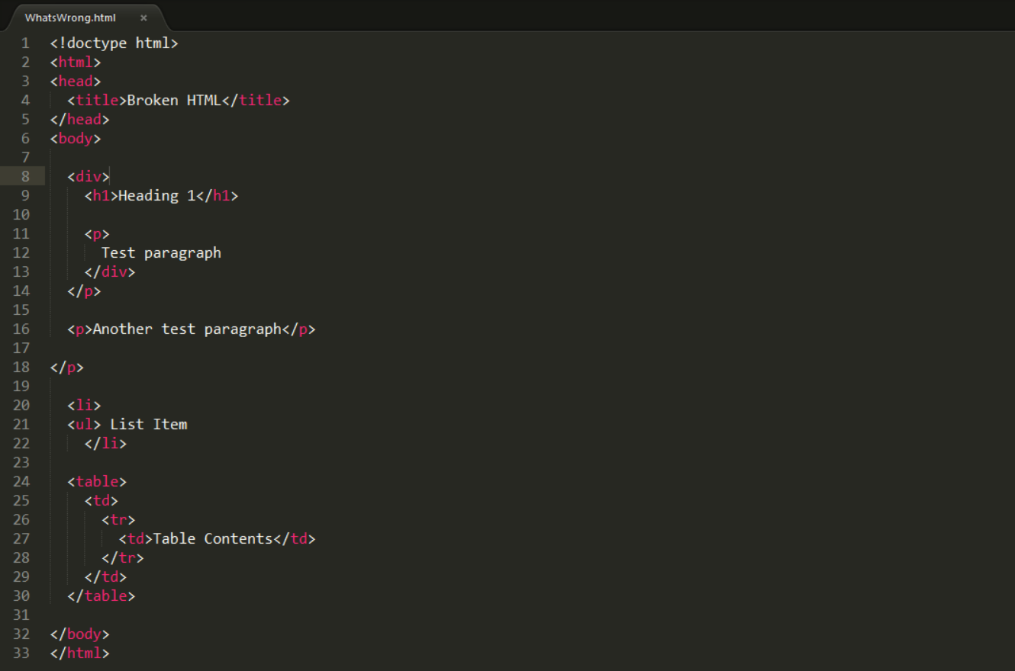
What’s Wrong Here?
© 2016 | RCB - All Rights Reserved
© 2016 | Rutgers Coding Bootcamp - All Rights Reserved

Slide 39
HTML Syntax (Basic)
Content
<h1>
This is Mah House
</h1>
Opening Tag
Closing Tag
© 2016 | RCB - All Rights Reserved
© 2016 | Rutgers Coding Bootcamp - All Rights Reserved

Slide 40
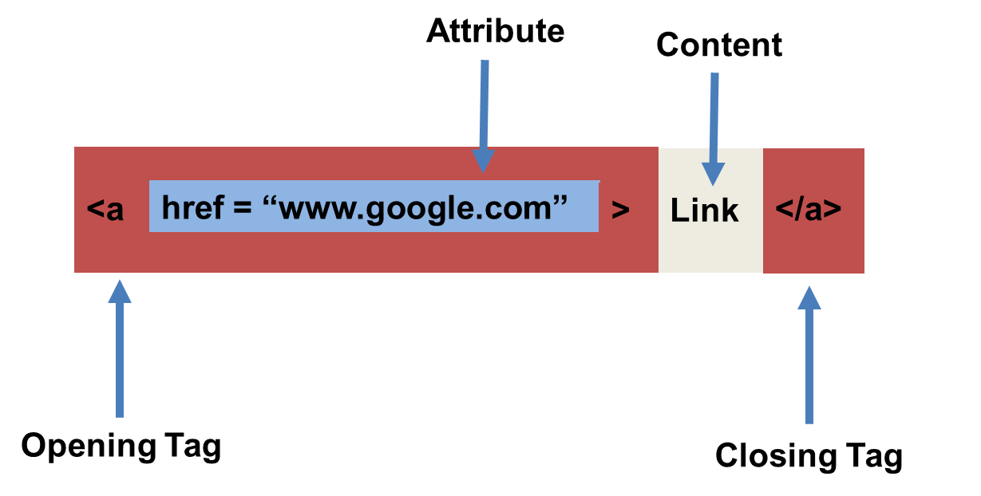
HTML Syntax (with Attribute)
© 2016 | RCB - All Rights Reserved
© 2016 | Rutgers Coding Bootcamp - All Rights Reserved

Slide 41
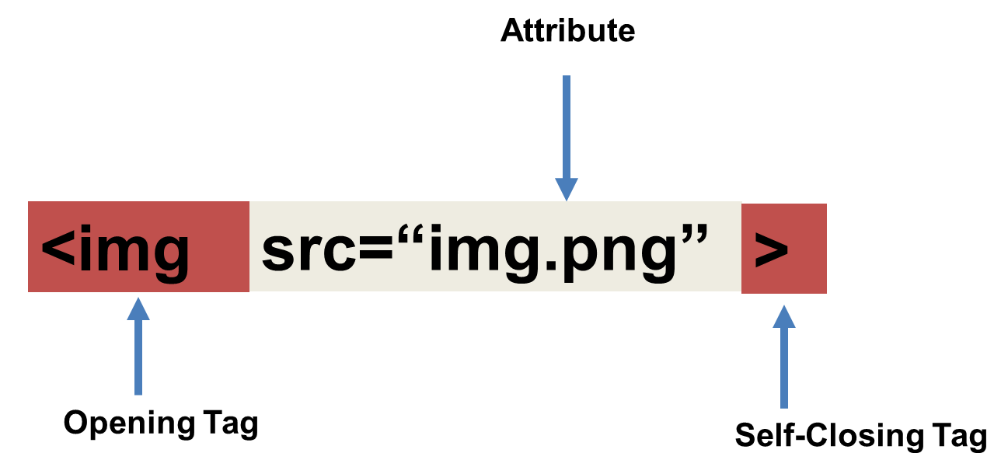
Tricky Tags (Self-Closing)
© 2016 | RCB - All Rights Reserved
© 2016 | Rutgers Coding Bootcamp - All Rights Reserved

Slide 42
Important Common Tags
Headers:
<h1> </h1> - Header 1 (Largest Header)
<h2> </h2> - Header 2 (Next Largest Header)
<h3> </h3> - Header 3
…
Containers:
<html> </html> - Wraps the entire page
<head> </head> - Wraps the header of the page
<body> </body> - Wraps the main content
<div> </div> - Logical Container ***
<p> </p> - Wraps individual Paragraphs
Others:
<strong> (bold), <em> (emphasis)
<img> (images), <a href> (links), <li> (list items) , <title> (title), <br> (line break), <table> (tables), <!-- --> (comments)
© 2016 | RCB - All Rights Reserved
© 2016 | Rutgers Coding Bootcamp - All Rights Reserved

Slide 43
Less Common Tags
All HTML Tags are listed here: http://www.w3schools.com/tags/
Don’t try to memorize them! Simply refer back to documentation as needed.
Other tags:
<video> for Videos
<audio> for Audio files
<embed> for Embedded files
<code> for including computer code
<header> for headers
<nav> for navigation bars
<footer> for footers
© 2016 | RCB - All Rights Reserved
© 2016 | Rutgers Coding Bootcamp - All Rights Reserved

Slide 44
HTML for Forms
Common UI (User Interface) Form Elements:
<form> - Creates a form section in HTML
<input> - Input boxes
<label> - Labels for boxes
<button> - Button
<textarea> - Large textbox
© 2016 | RCB - All Rights Reserved
© 2016 | Rutgers Coding Bootcamp - All Rights Reserved

Slide 45
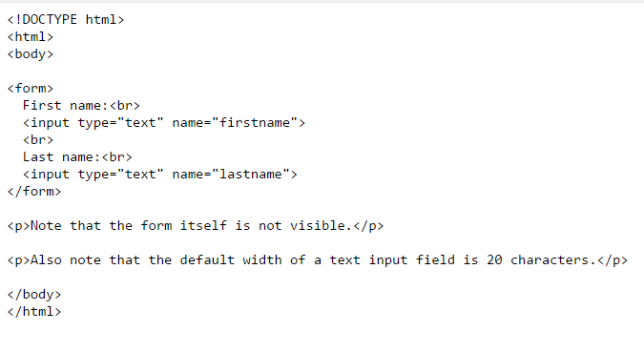
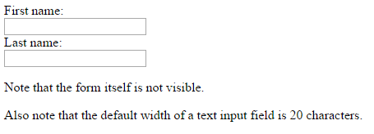
HTML for Forms
© 2016 | RCB - All Rights Reserved
© 2016 | Rutgers Coding Bootcamp - All Rights Reserved

Slide 46
> YOUR TURN!!
Assignment
In this activity, you’ll be creating a student bio using HTML. You will then add, commit, and push your completed HTML to GitHub for the world to see.
Additional instructions, sent via Slack.
© 2016 | RCB - All Rights Reserved
Notes:
Send snapshot from Git command line

Slide 47
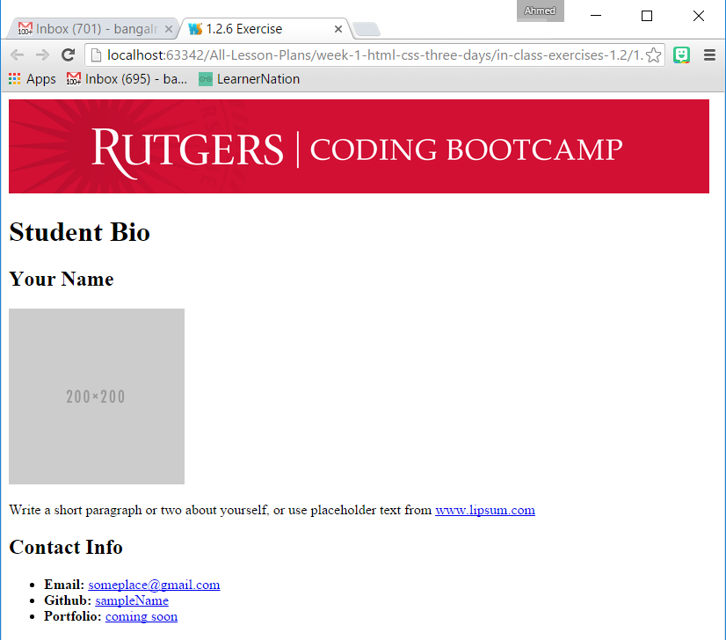
> YOUR TURN!!
© 2016 | RCB - All Rights Reserved
Notes:
Send snapshot from Git command line

Slide 48
Break?
© 2016 | RCB - All Rights Reserved
Notes:
7:00 – 7:05

Slide 49
CSS Stylin’
© 2016 | RCB - All Rights Reserved
Notes:
7:00 – 7:05

Slide 50


HTML / CSS Definitions (*yawn* unimportant)
HTML: Hypertext Markup Language – (Content)
CSS: Cascading Style Sheets – (Appearance)
HTML/CSS are the “languages of the web”. Together they define both the content and the aesthetics of a webpage – handling everything from the layouts, colors, fonts, and content placement. (Javascript is the third – handling logic, animation, etc.)
© 2016 | RCB - All Rights Reserved
© 2016 | Rutgers Coding Bootcamp - All Rights Reserved

Slide 51


HTML vs HTML/CSS
HTML Alone
Like writing papers in “Notepad”.
Can only write unformatted text.
HTML / CSS
Like writing papers in Microsoft Word.
Can format text, page settings, alignment, etc. based on “highlighting” and menu options.
© 2016 | RCB - All Rights Reserved
© 2016 | Rutgers Coding Bootcamp - All Rights Reserved

Slide 52
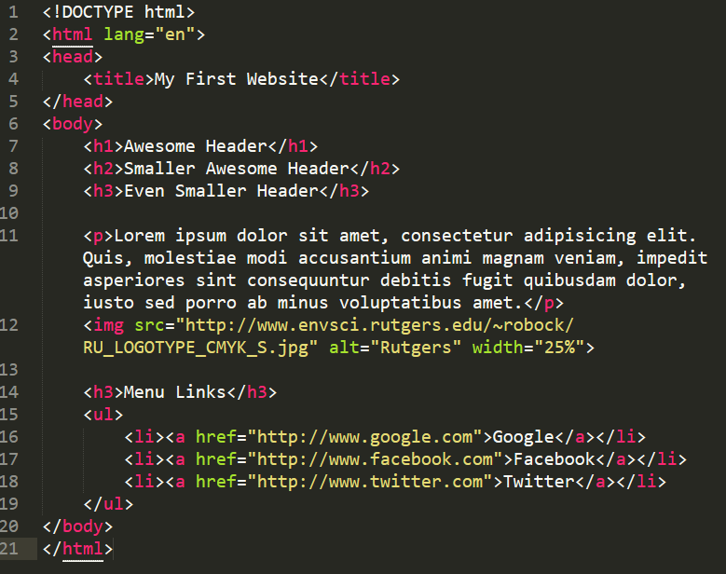
Basic HTML Page
© 2016 | RCB - All Rights Reserved
© 2016 | Rutgers Coding Bootcamp - All Rights Reserved

Slide 53
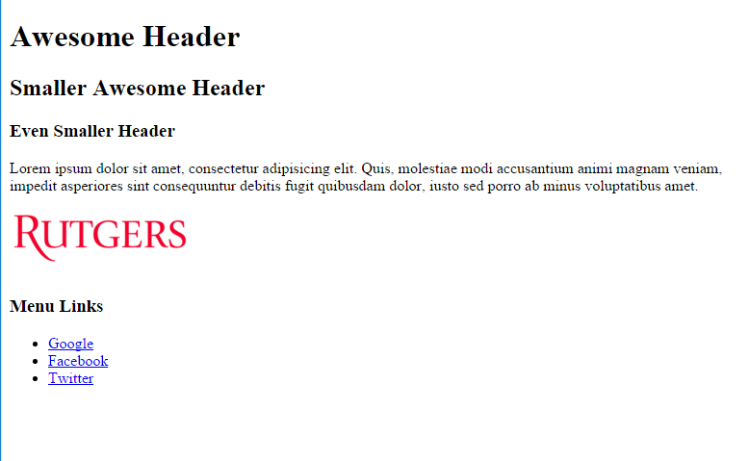
Basic HTML Page
© 2016 | RCB - All Rights Reserved
© 2016 | Rutgers Coding Bootcamp - All Rights Reserved

Slide 54
Basic HTML Page
Hella Boring…
© 2016 | RCB - All Rights Reserved
© 2016 | Rutgers Coding Bootcamp - All Rights Reserved

Slide 55
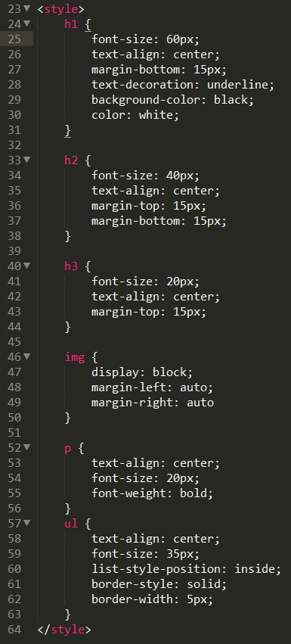
Enter CSS
© 2016 | RCB - All Rights Reserved
© 2016 | Rutgers Coding Bootcamp - All Rights Reserved

Slide 56
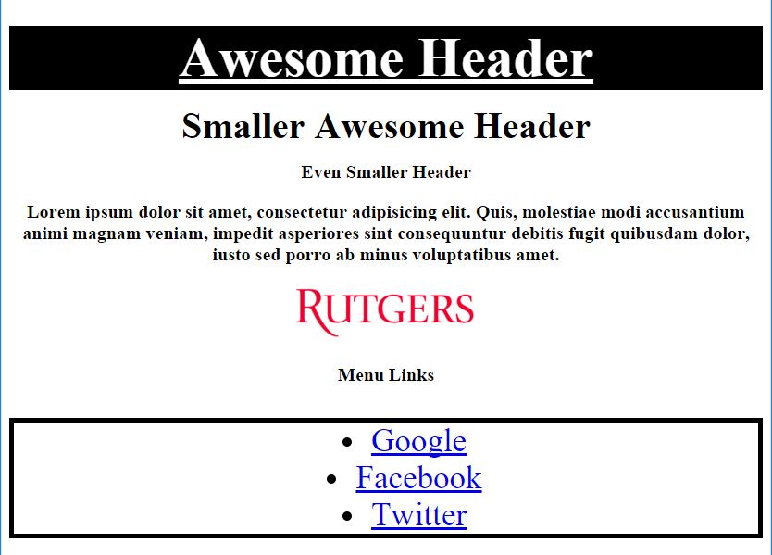
Enter CSS
© 2016 | RCB - All Rights Reserved
© 2016 | Rutgers Coding Bootcamp - All Rights Reserved

Slide 57

CSS Syntax
CSS works by hooking onto selectors added into HTML using “classes and identifiers”.
Once hooked, we apply styles to those HTML elements using css .
© 2016 | RCB - All Rights Reserved
© 2016 | Rutgers Coding Bootcamp - All Rights Reserved

Slide 58
CSS Example
In the below example the “Header” would be turned blue and MUCH larger, because of the CSS.
If we’d like to apply a CSS style selectively, we can incorporate a class or ID. Just remember to include the necessary symbol (. or #) before the css.
Example (HTML):
<p class=“bigBlue”>Header</p>
Example (CSS):
.bigBlue
{
font-size: 100px;
color: blue;
}
© 2016 | RCB - All Rights Reserved
© 2016 | Rutgers Coding Bootcamp - All Rights Reserved

Slide 59
Key CSS Attributes
Font / Color:
color: Sets color of text
font-size: Sets size of the font
font-style: Sets italics
font-weight: Sets bold
Alignment / Spacing:
margin-top(bottom/left/right): Adds space between element and its own border.
margin-top (bottom/left/right): Adds space between element and surrounding elements.
float: Forces elements to the sides, centers, or tops
Background:
background-color: sets background color
background-image: sets background image
© 2016 | RCB - All Rights Reserved
© 2016 | Rutgers Coding Bootcamp - All Rights Reserved

Slide 60
Powerful Duo
Believe it or not… HTML / CSS is all you need to develop a full-blown rich looking website.
© 2016 | RCB - All Rights Reserved
© 2016 | Rutgers Coding Bootcamp - All Rights Reserved

Slide 61
CSS Show!
© 2016 | RCB - All Rights Reserved
Notes:
7:00 – 7:05

Slide 62
> YOUR TURN!!
Assignment
In this activity, you’ll be upgrading your previous HTML bio using CSS styles. Once you are done with your changes, you’ll commit and push these changes up to GitHub.
Additional instructions, sent via Slack.
© 2016 | RCB - All Rights Reserved
Notes:
Send snapshot from Git command line

Slide 63
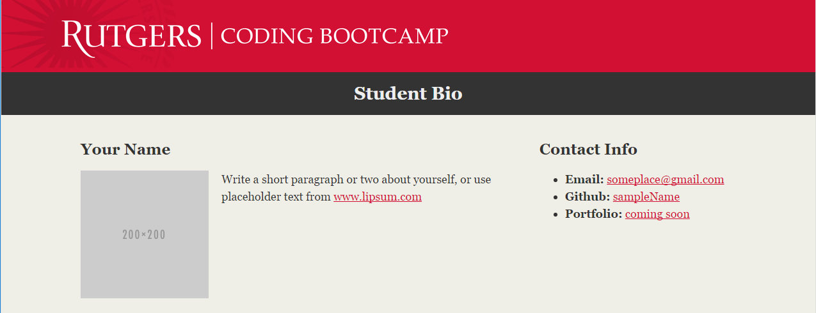
> YOUR TURN!!
© 2016 | RCB - All Rights Reserved
Notes:
Send snapshot from Git command line

Slide 64
Recap + Questions
© 2016 | RCB - All Rights Reserved
Notes:
7:00 – 7:05

Slide 65
Know Thyself
If you are a complete beginner to HTML/CSS and Coding…
Continue getting comfortable with HTML.
Be able to completely write a basic HTML document (like in last class)
Understand what CSS is, what its for, and how it works with HTML
********** Be able to use Git and GitHub to upload code
If you’ve had past exposure and felt comfortable with the last lesson…
Aim to build up your skills. Clear up questions or confusions about HTML
Become knowledgeable about a wider range of HTML and CSS tags
Be able to selectively apply CSS to specific HTML elements
********* Be able to use Git and GitHub to upload code.
© 2016 | RCB - All Rights Reserved
© 2016 | Rutgers Coding Bootcamp - All Rights Reserved

